Slide 1
MRA TAX REGISTRATION SYSTEM
THABIT ISSAH

Slide 2
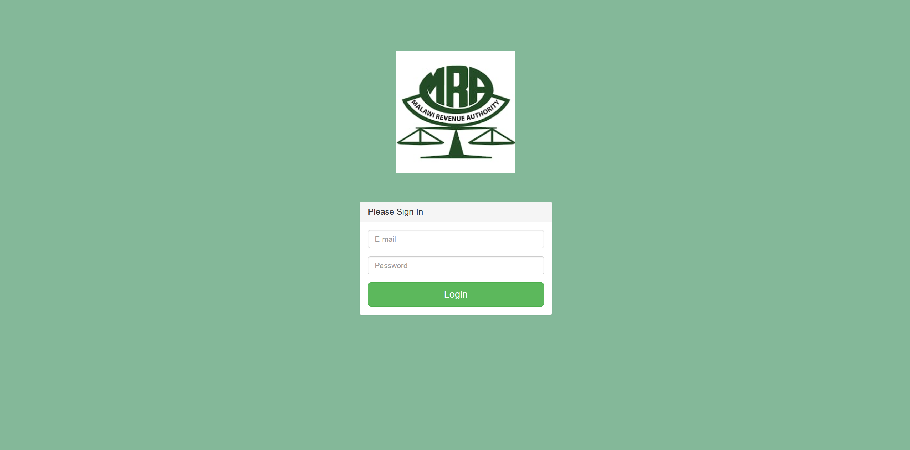
Login Page

Slide 3
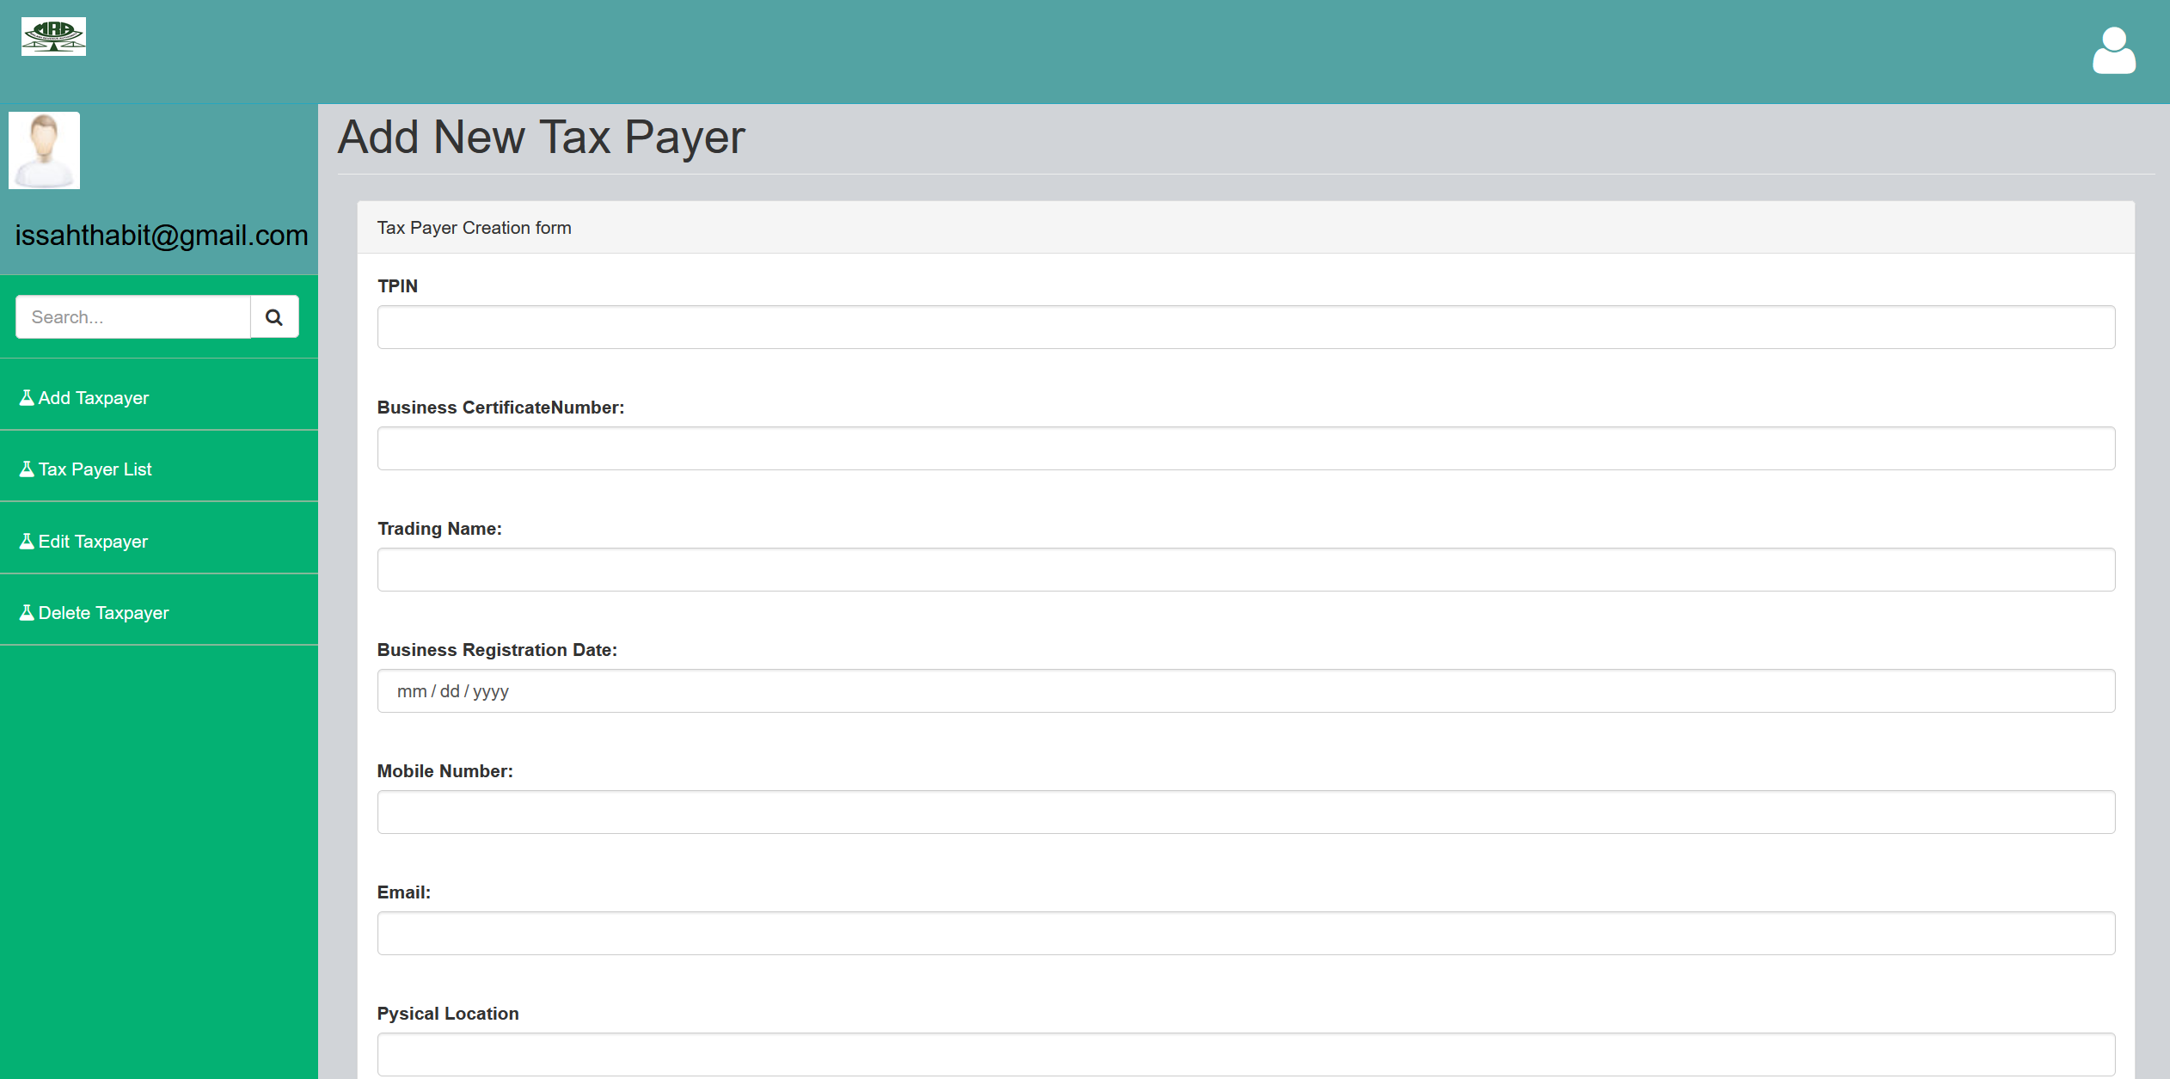
Taxpayer Creation Page

Slide 4
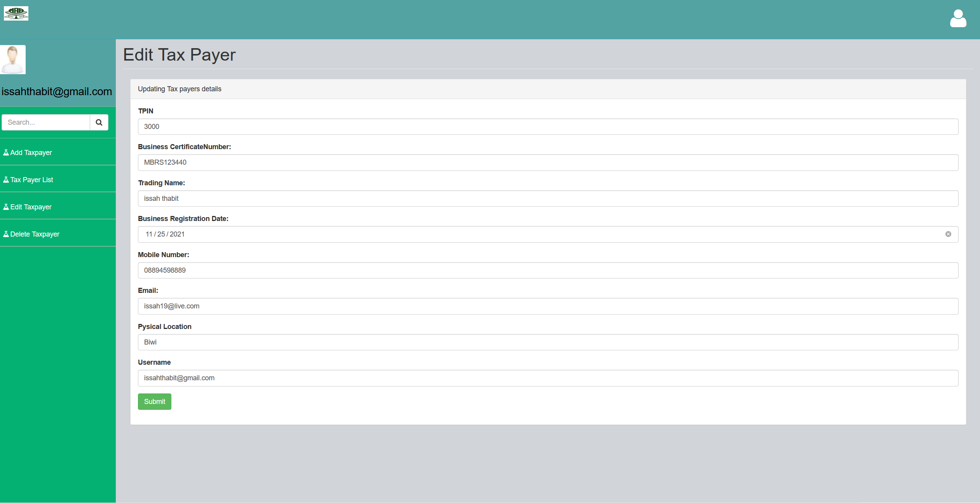
Edit Tax Payer

Slide 5
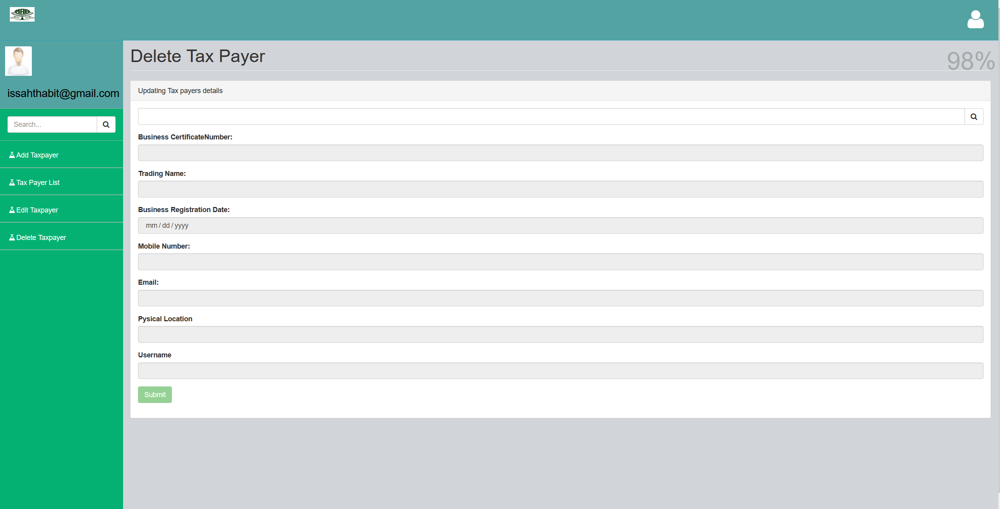
Delete Tax Payer

Slide 6
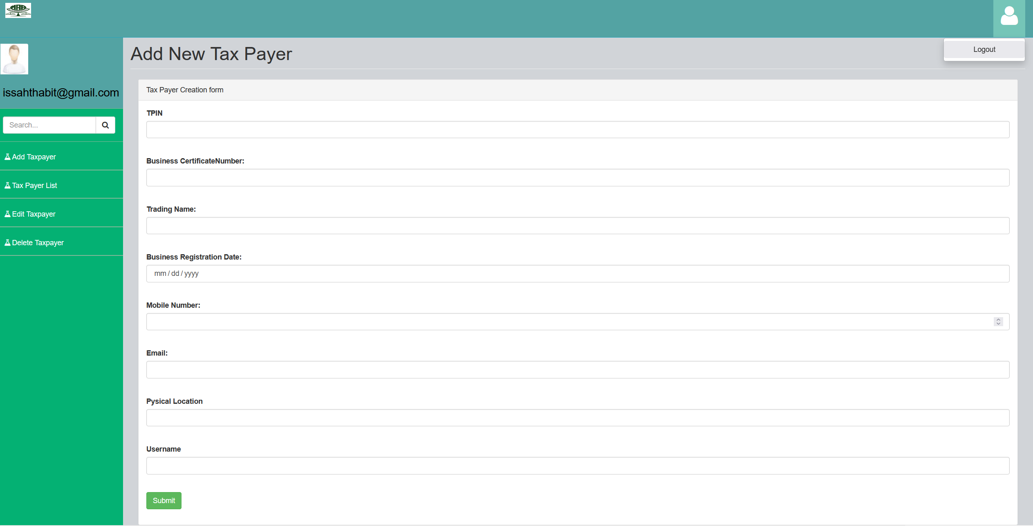
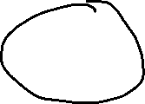
Logout
Click on top right corner dropdown button and select Logout

Slide 7
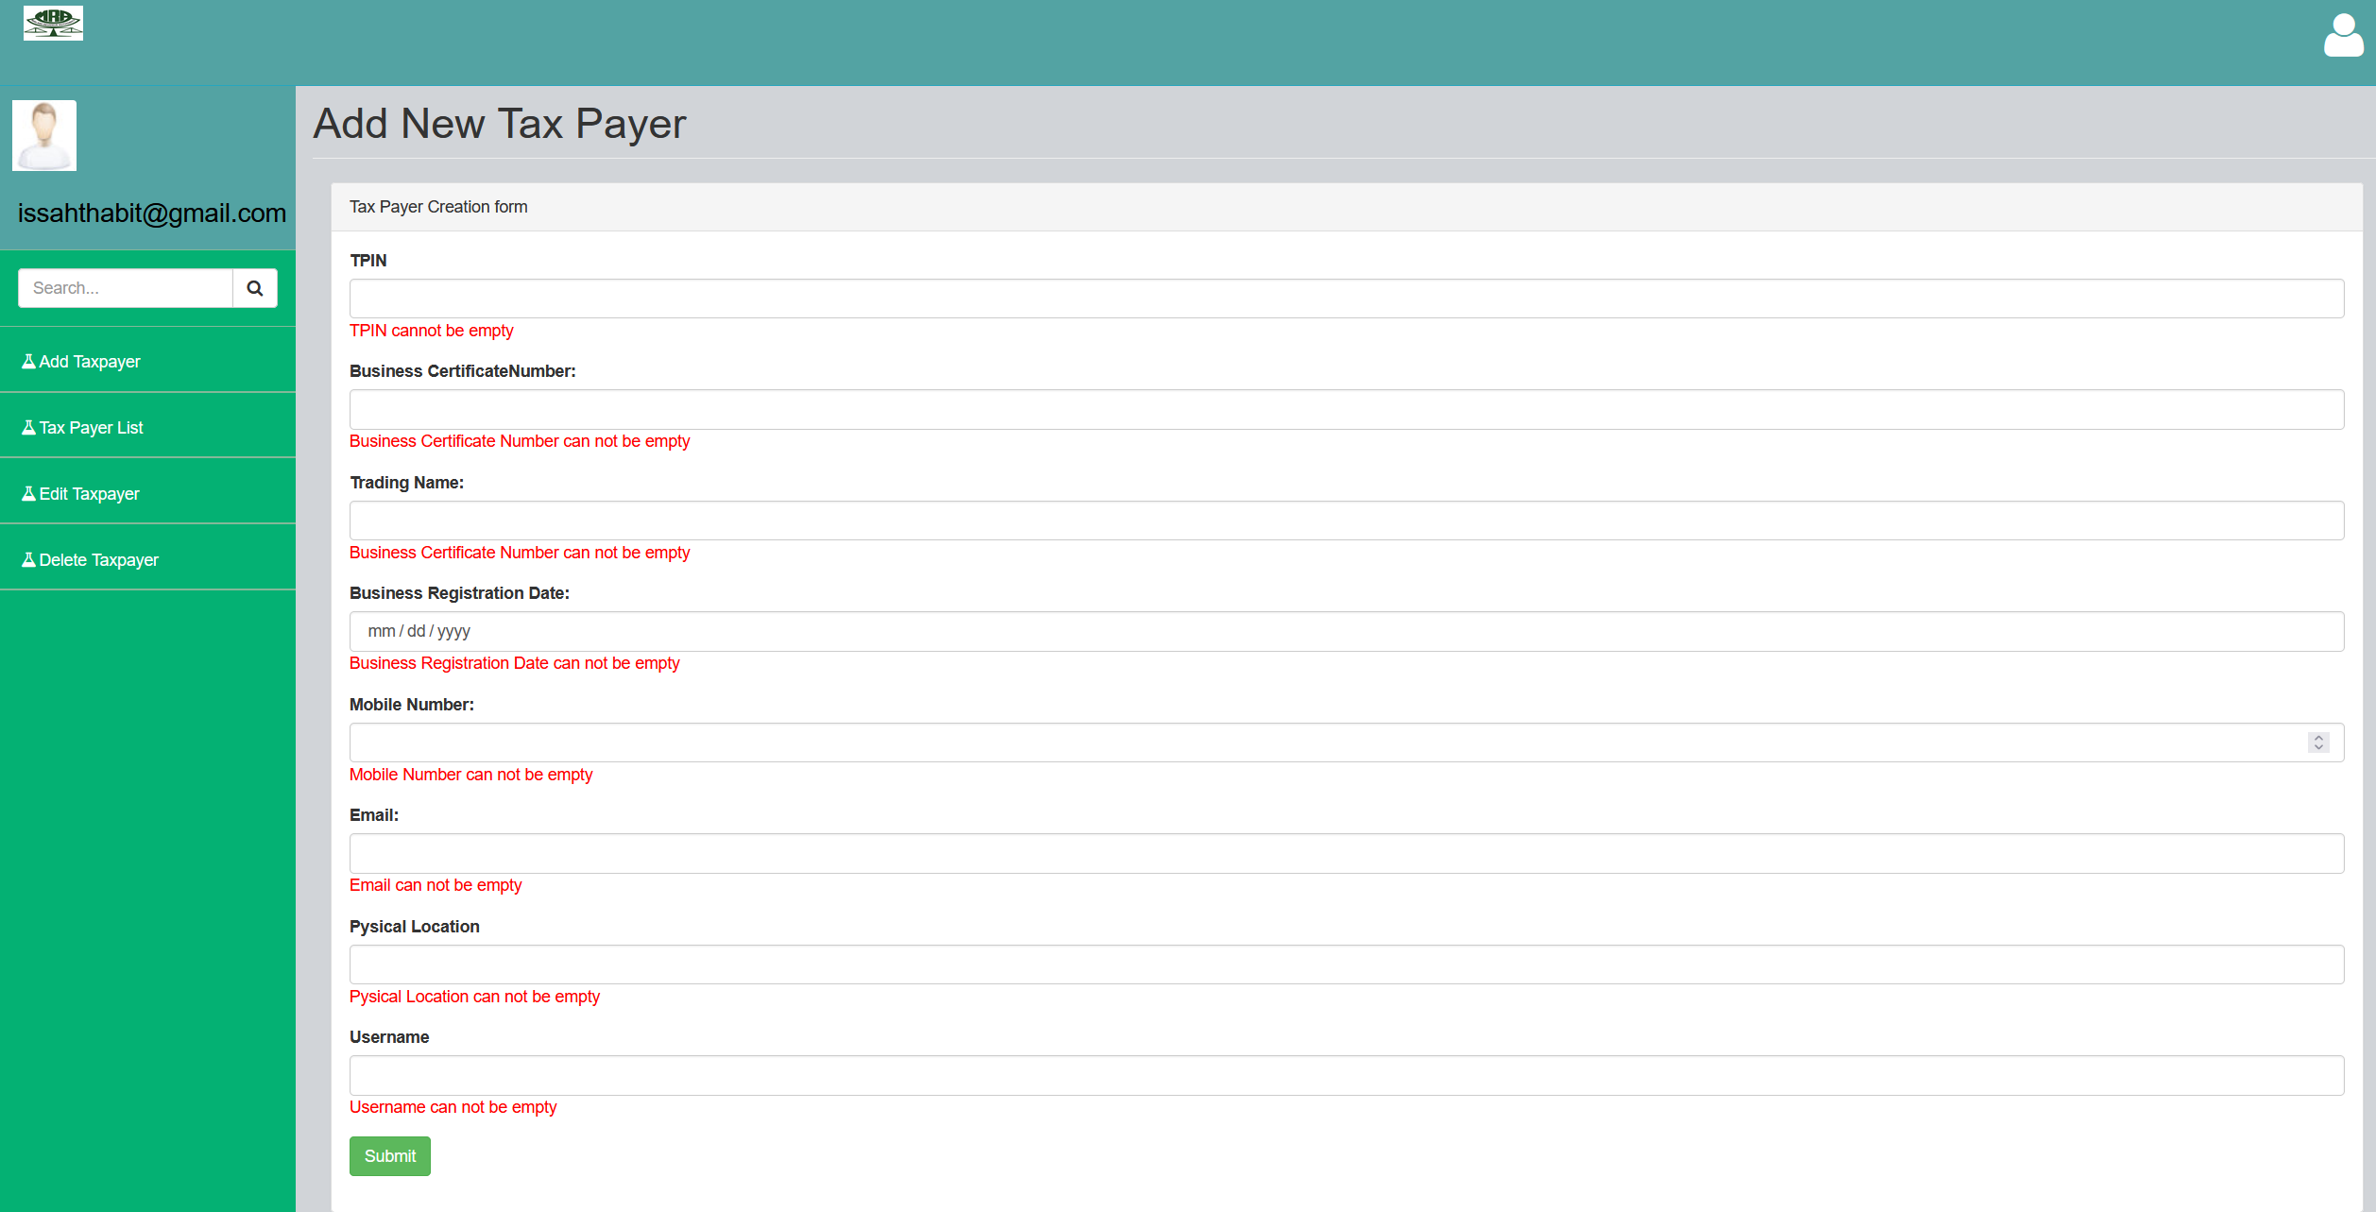
Validations

Slide 8
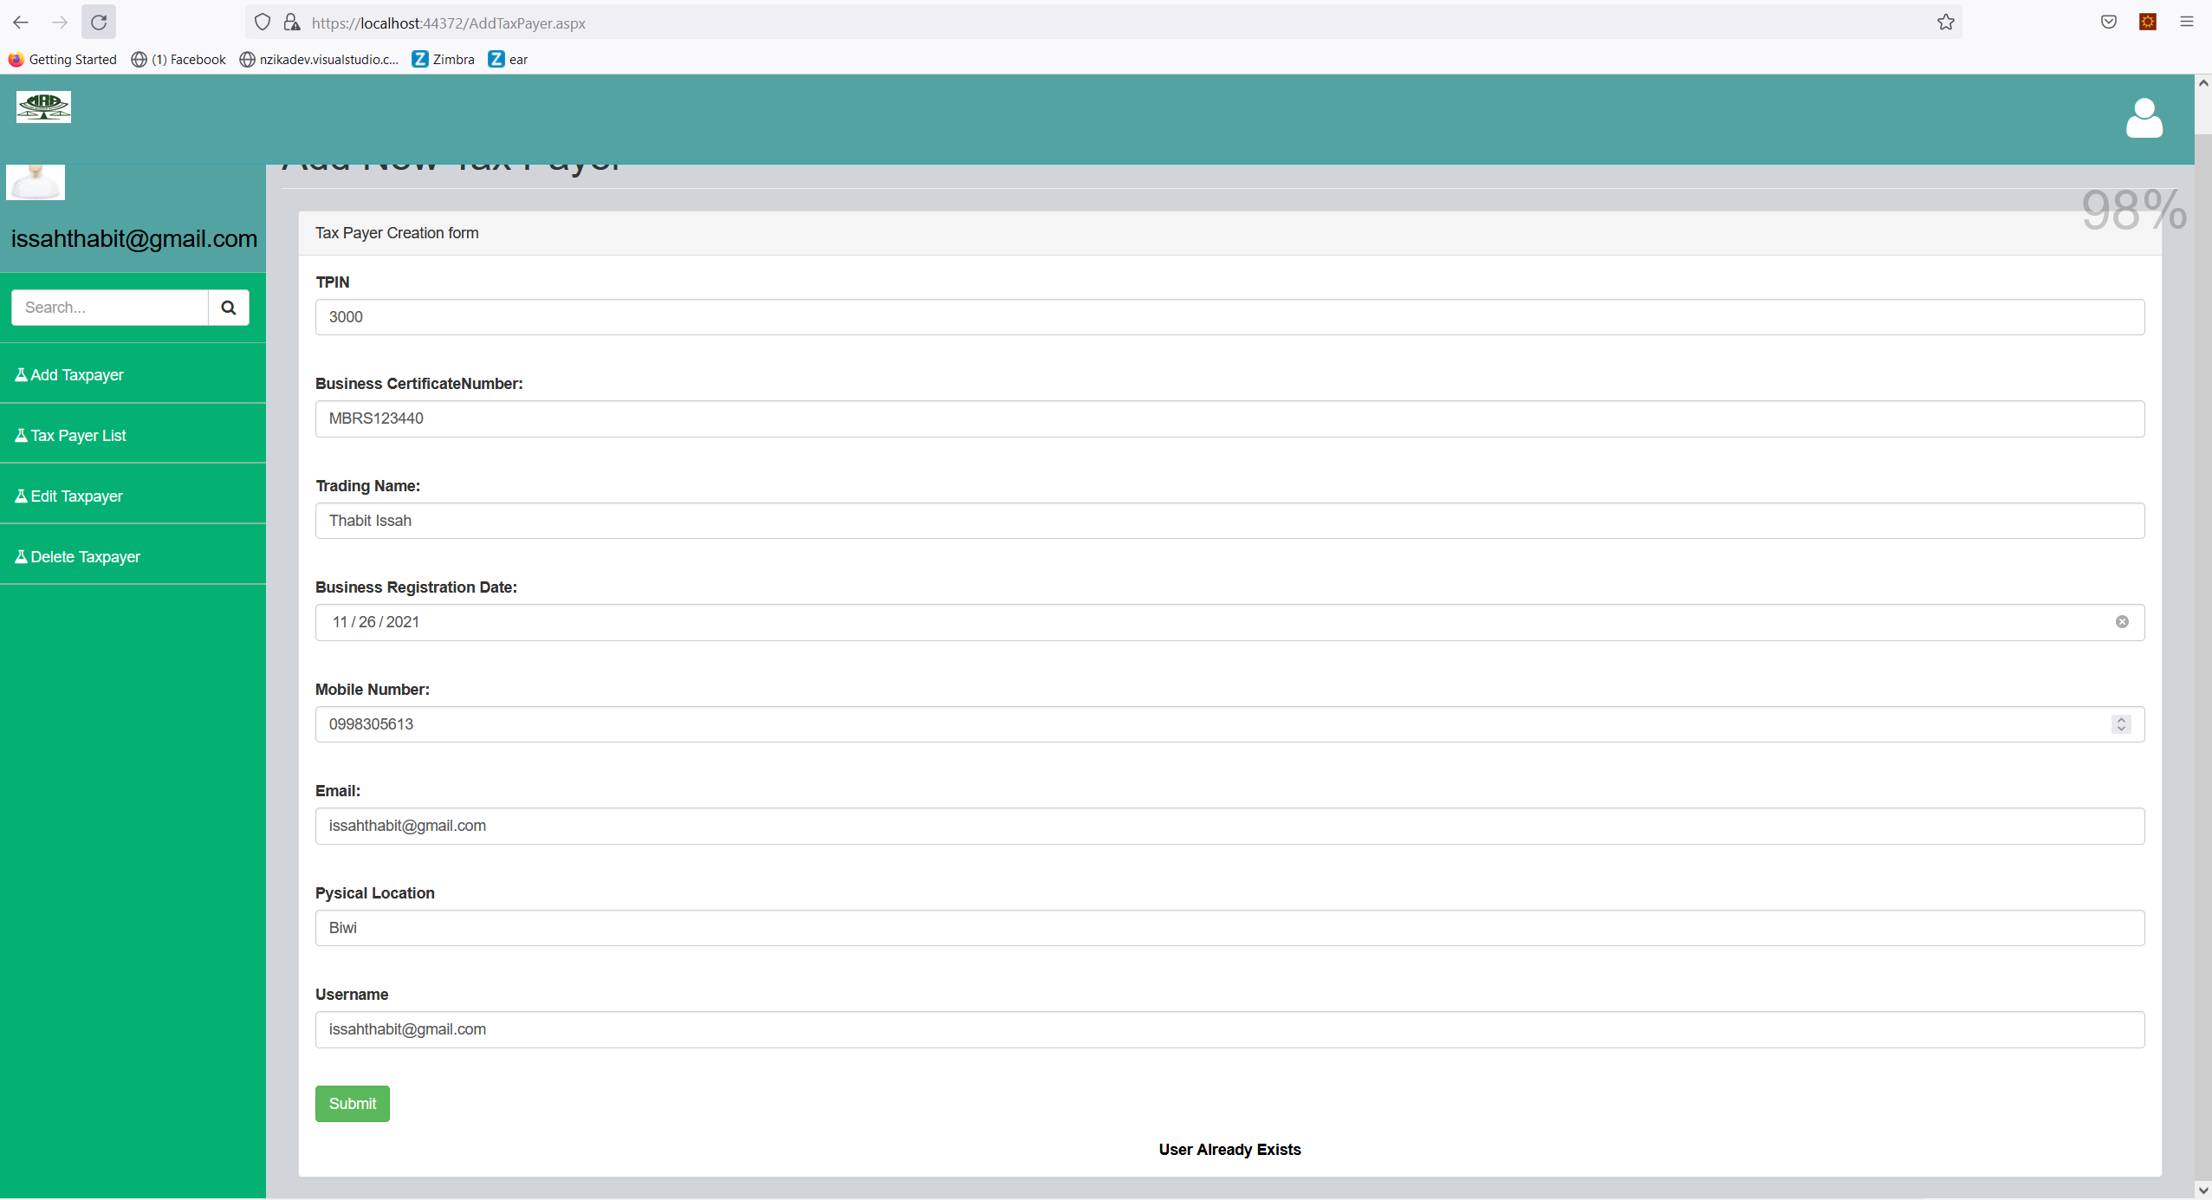
Status Codes – User already Exists

Slide 9
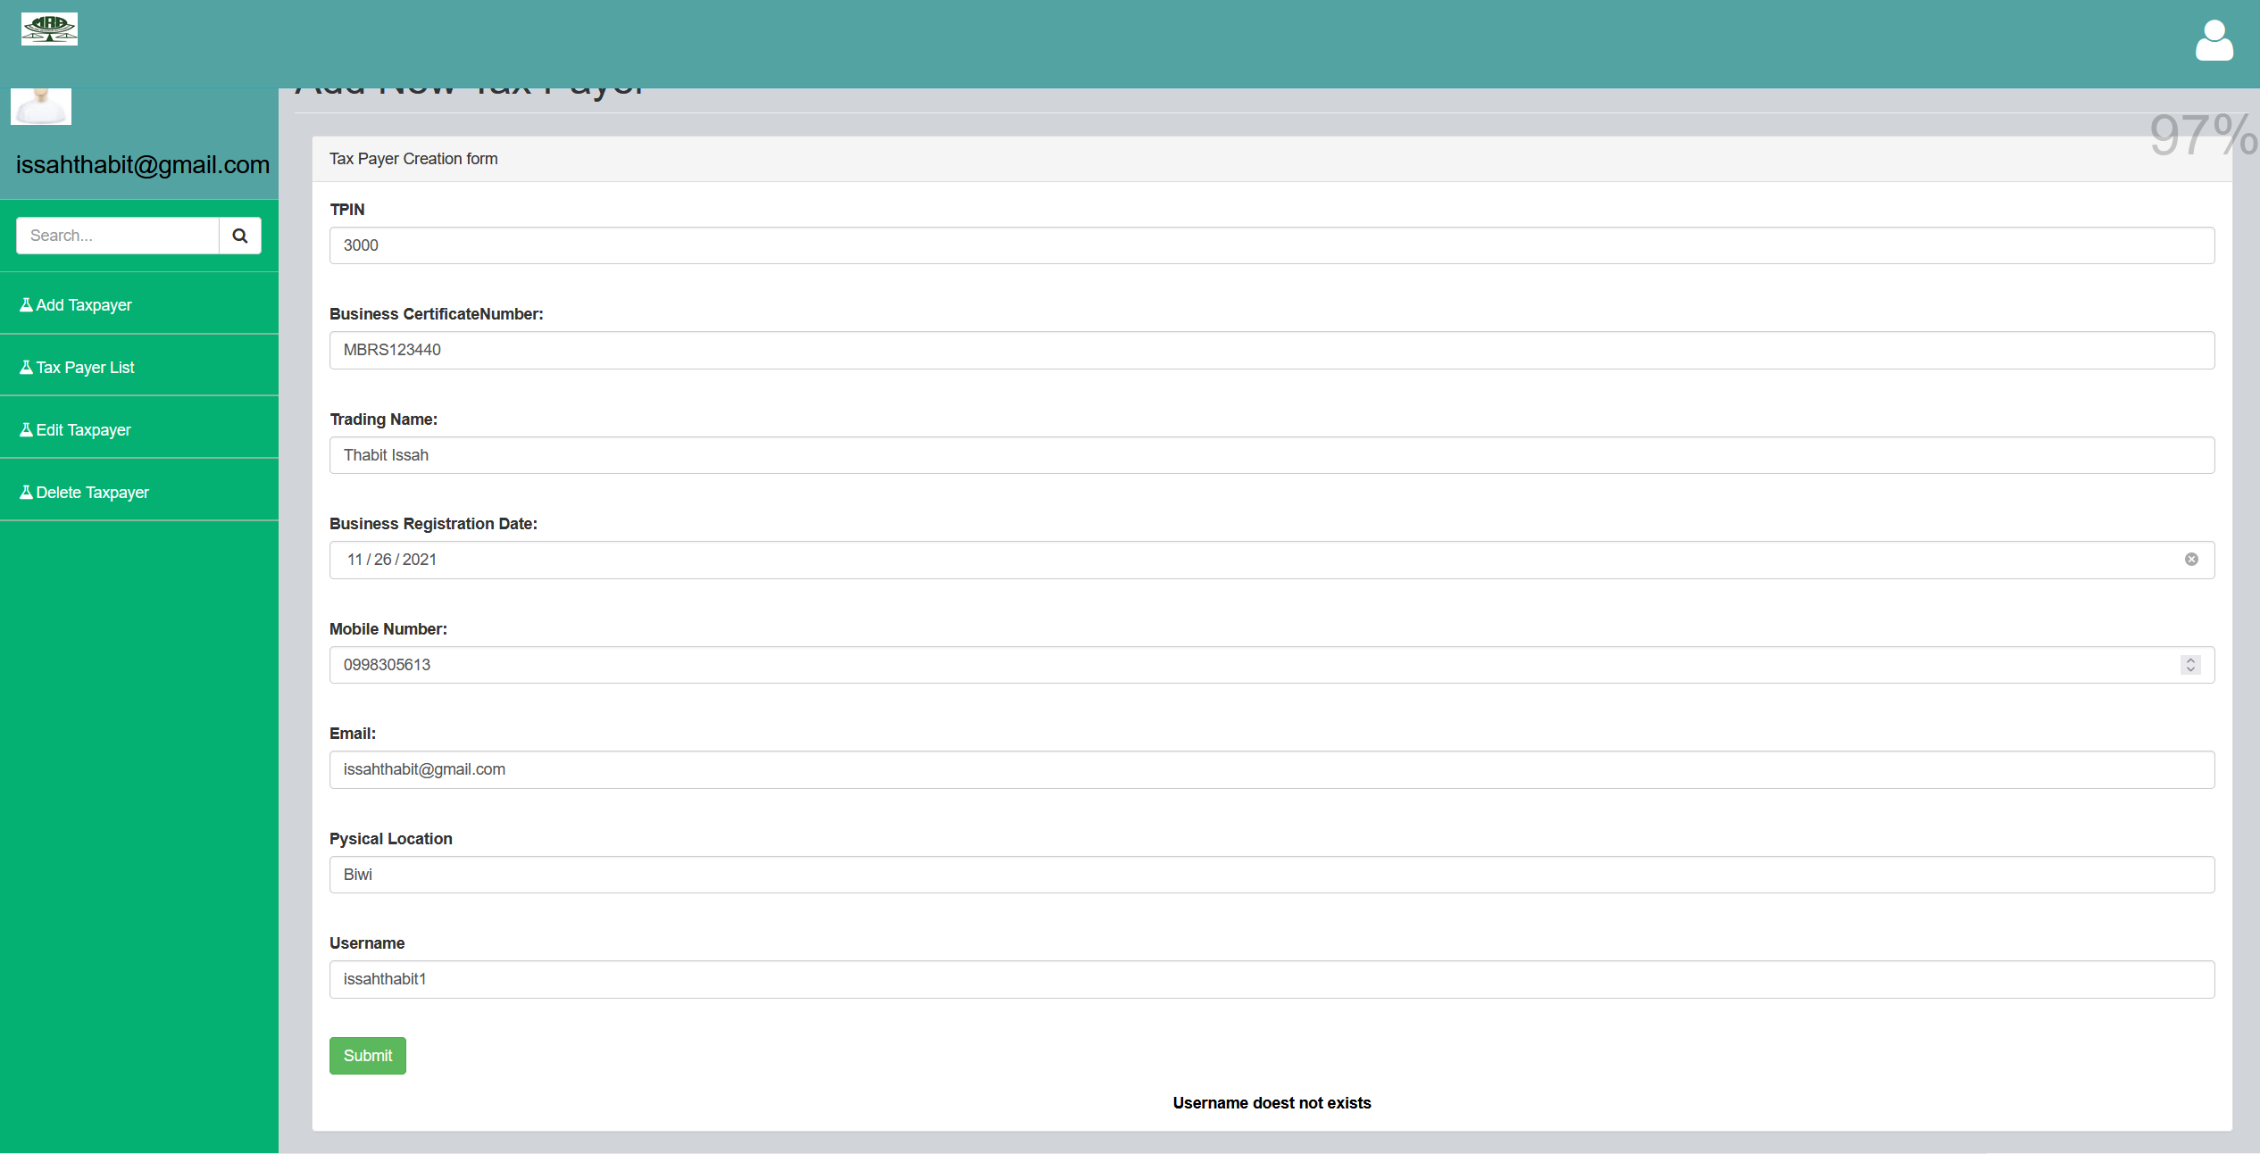
Status Codes – User already does not exists

Slide 10

Status Codes – User saved successfully

